Slide 1
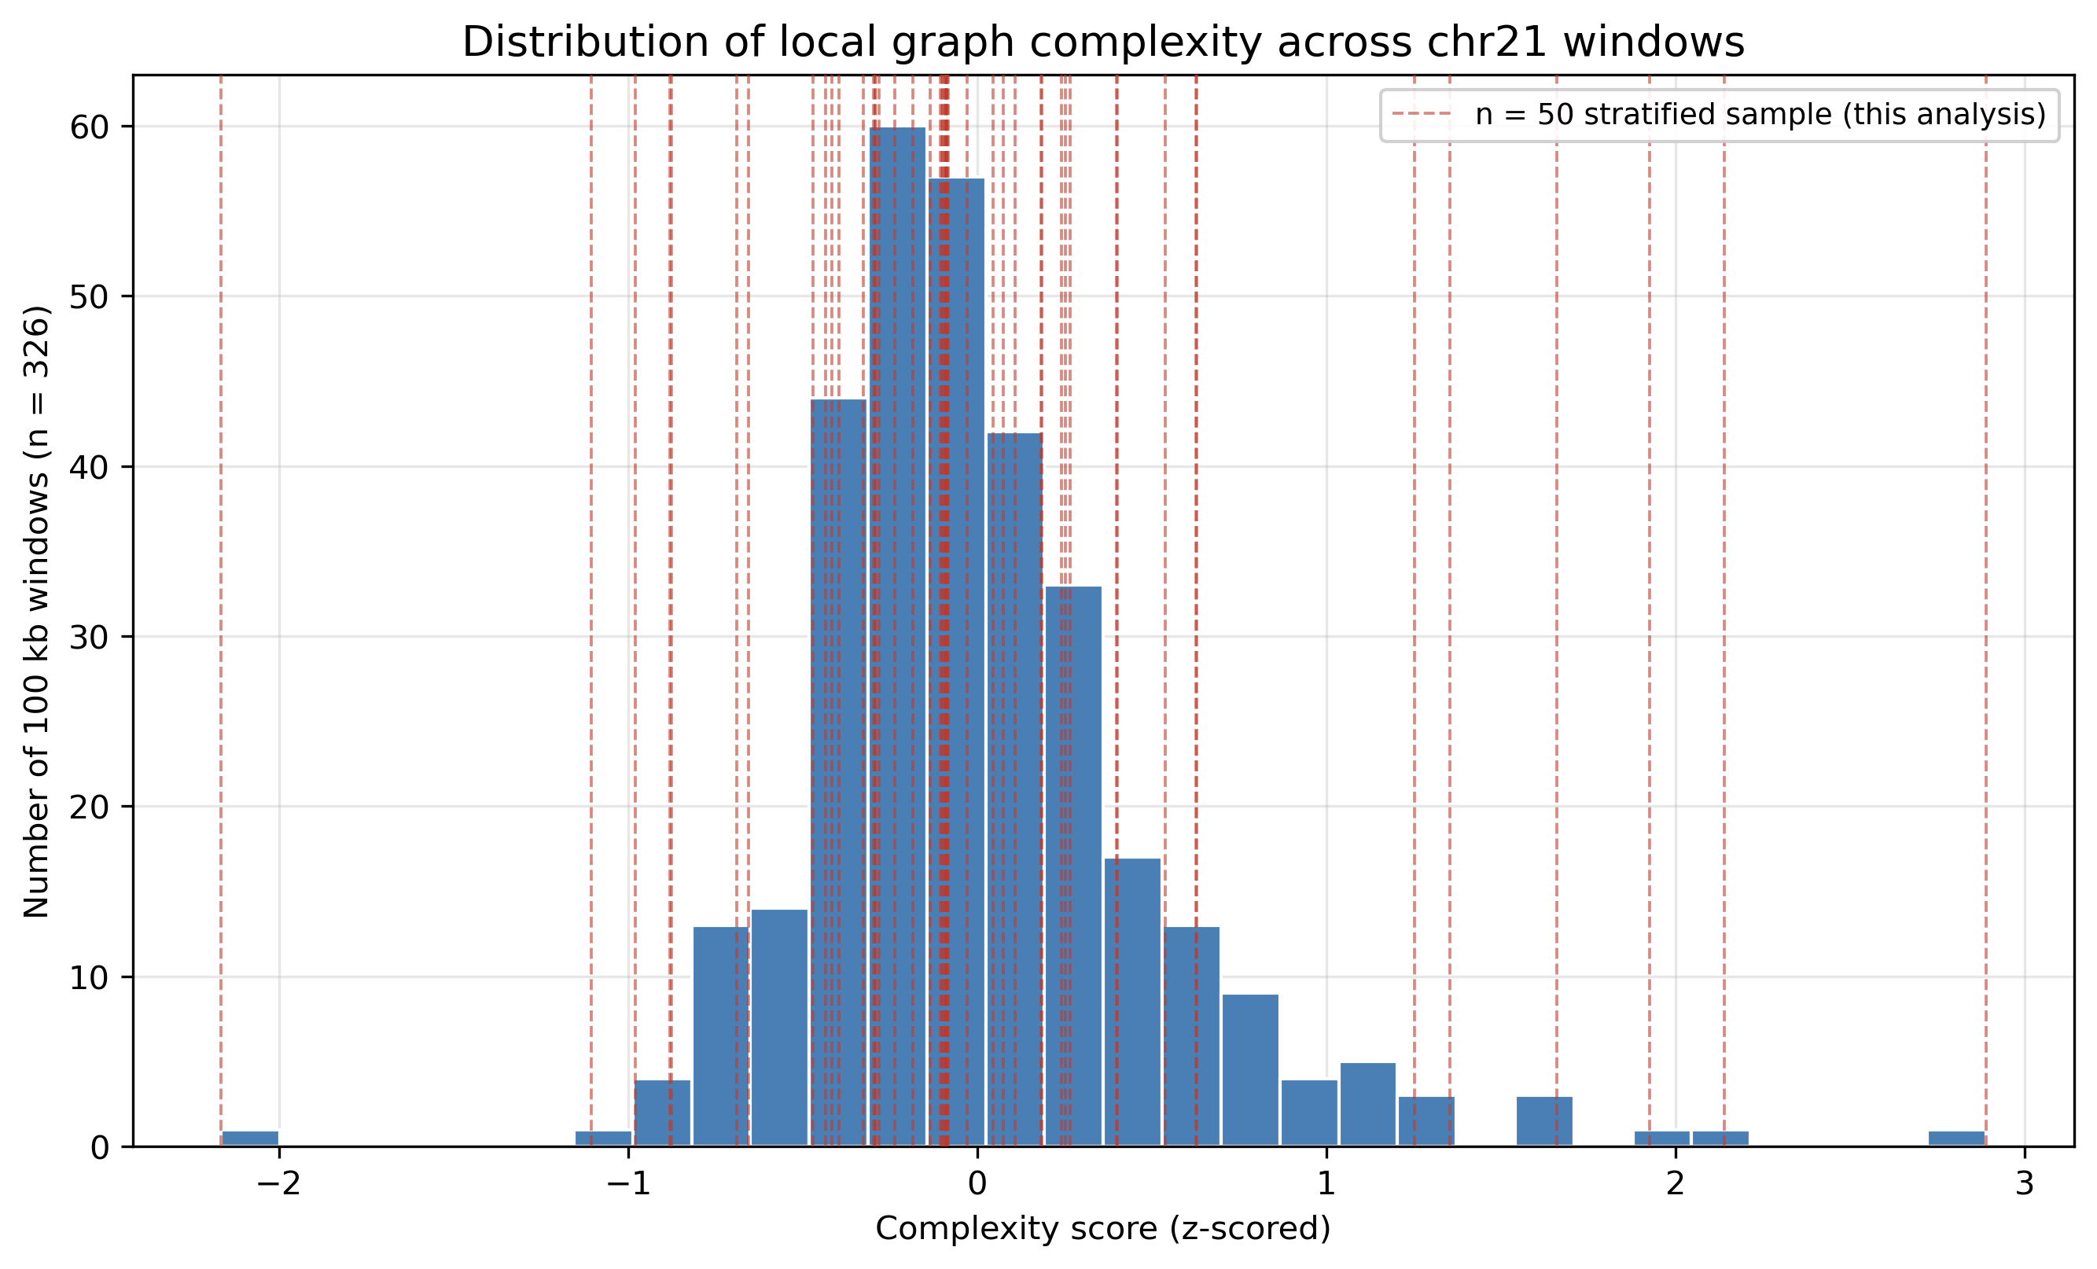
Does local graph complexity predict vg Giraffe indexing cost and mapping accuracy
on a PGGB pangenome graph?
Pangenome graphs combine hundreds of human haplotypes into one graph. “vg Giraffe” is the standard short-read mapper for them.
2025: the vg Giraffe team reports they still cannot build genome-scale Giraffe indexes for PGGB graphs, due to topology.
This project tests a smaller, local version: 100 kb windows on human chromosome 21.
466 haplotypes · 367 windows screened · 50 regions analyzed
Figure 1. Complexity score across 326 valid windows — right-skewed, hence a stratified sample.
Notes:
This project looks at pangenome graphs -- graphs built from many human genomes at once with a tool called PGGB, so mapping can account for real human genetic diversity instead of one reference. The vg Giraffe team published this year that they still cannot build genome-scale Giraffe indexes for PGGB graphs -- the topology is too complex, an open, unsolved problem. So we asked a narrower, testable version of it at a small local scale: 100 kilobase windows on human chromosome 21. We computed an explicit complexity score for all 326 valid windows -- shown in figure 1 -- and the distribution is heavily right-skewed, with most windows clustered near the median. That is exactly why we did not sample uniformly: we drew a stratified sample of 50 regions, balanced across complexity and a separate known-hazard annotation, so that rare extreme and hazardous windows would not be missed.

Slide 2
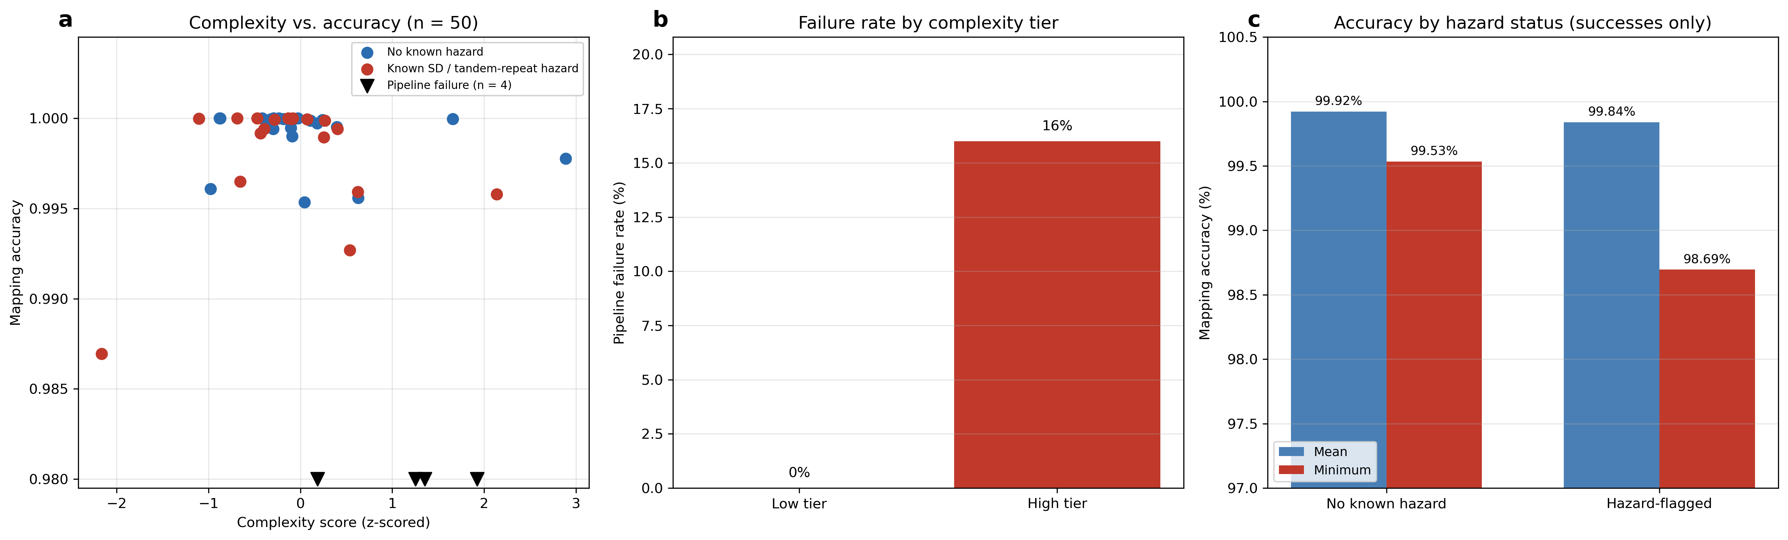
Results: complexity score and known-hazard annotation predict different outcomes
Outcome | Predictor | Result (n = 50)
Pipeline completes at all | Complexity tier (low vs. high) | 0% failed below the median score; 16% above it
Mapping accuracy, given completion | Known-hazard flag (segmental duplication or large tandem repeat) | Minimum accuracy 99.53% without the flag; 98.69% with it
Note: "failed" means no result within a fixed 30-minute compute budget per region, not proven intractability. With only 4 failures among 25 high-complexity regions, 16% is approximate.
Notes:
We did not stop at a handful of hand-picked regions, because our first small comparison gave misleading signals. So we built a systematic design: for each of 326 valid 100-kilobase windows on chromosome 21, we computed both a complexity score from local graph topology, and a separate known-hazard flag -- whether the region overlaps a segmental duplication or large tandem repeat, using public UCSC annotation tracks. We sampled 50 regions across all four combinations of high and low complexity, hazard and no hazard, and ran the full indexing and mapping pipeline on each, replicating at three growing sample sizes to confirm the pattern held. The result, shown in this three-panel figure: complexity score reliably predicts whether the pipeline finishes at all -- 0 percent failure below the median score, 16 percent above it. But it does not predict accuracy among the regions that do finish. That is predicted instead by the hazard flag: no known hazard, minimum accuracy 99.5 percent; hazard-flagged, as low as 98.7 percent. One important caveat: failure was defined by a fixed 30-minute compute budget per region. We know from earlier in this project that this ceiling matters -- two regions we originally logged as failures under a 10-minute budget turned out to complete successfully once we gave them 30 minutes. So the 16 percent failure rate should be read as an upper bound under our specific resource budget, not proof that those regions are mathematically impossible to index, and the exact percentage carries real statistical uncertainty given only 4 events.

Slide 3
Conclusions and limitations
Findings (n = 50)
Limitations
Complexity score predicts whether the pipeline completes — not accuracy.
Known-hazard annotation predicts accuracy loss — not completion.
"Failure" = no result within a 30-min, single-machine budget, not proven intractability.
16% comes from only 4 of 25 high-complexity regions — the exact figure is uncertain.
Notes:
To summarize. Two findings, each replicated across three independently grown sample sizes: n=20, n=30, n=50. First, complexity score predicts whether the pipeline completes within our compute budget, but not accuracy among completed regions. Second, the known-hazard annotation predicts accuracy loss among completed regions, but not whether the pipeline completes. Neither predictor substitutes for the other. Now the limitations, which matter for how strongly to read these numbers. Pipeline failure here means no result within a fixed thirty-minute, single-machine compute budget, not a proof of mathematical intractability -- we already saw two comparable cases elsewhere in this project succeed once given more time, so with a longer timeout some of the current sixteen percent might resolve too. Also, that sixteen percent comes from only four failure events out of twenty-five high-complexity regions, so while the pattern itself replicated three times, the precise percentage has real statistical uncertainty. We also have not tested whether more compute would close the gap, or whether this pattern holds outside chromosome 21.

